Slide 1
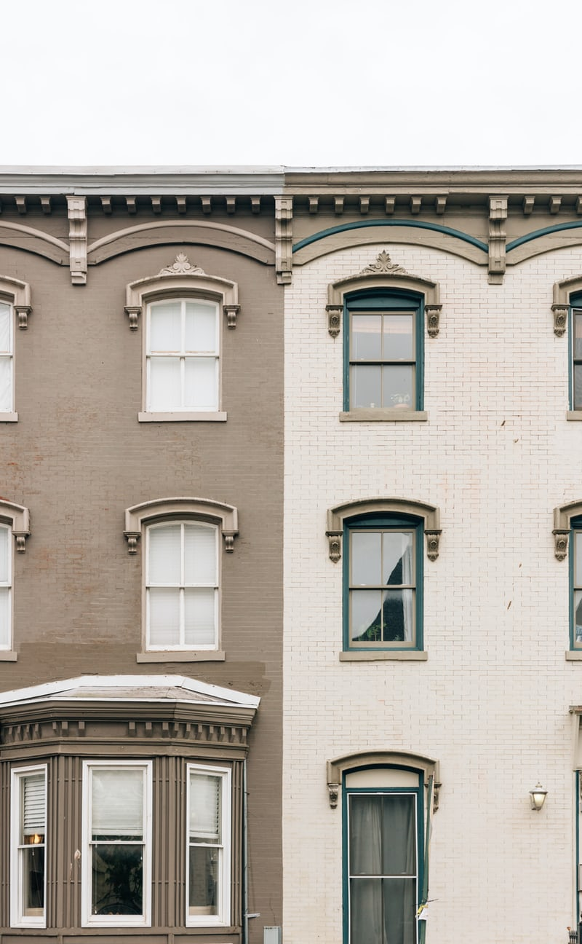
Flip-It DC Under-valued historic properties quick look
Alison Garrett, Find-It Analyst
1 October 2021

Slide 2
Introduction
Retro Renovations remodels historic homes into luxury properties
Corporate scouting showed untapped Washington, DC potential
Flip-It DC, a subsidiary, established to rapidly buy, renovate, and sell well positioned real estate for a sizable return on investment
Find-It Team is providing an initial quick look of the DC market

Slide 3
Approach
Collect
Analyze
Missing data using DC Real Property Search
Model
Sales Price LM Linear Regression Model
Predict
Select
Single family and row houses Sold under $3.6M
Single family and row houses For Sale, Contingent, and Under Contract
Target Sales Price compared with Asking Price and Property Assessment to identify target properties for Flip-It DC review
6 months of data focused on DC historical areas
HomeSnap features, price, and sales status
Target Sales Price predicted using Sales Price Model
Polynomial and Lasso regression with LARS feature fitting

Slide 4
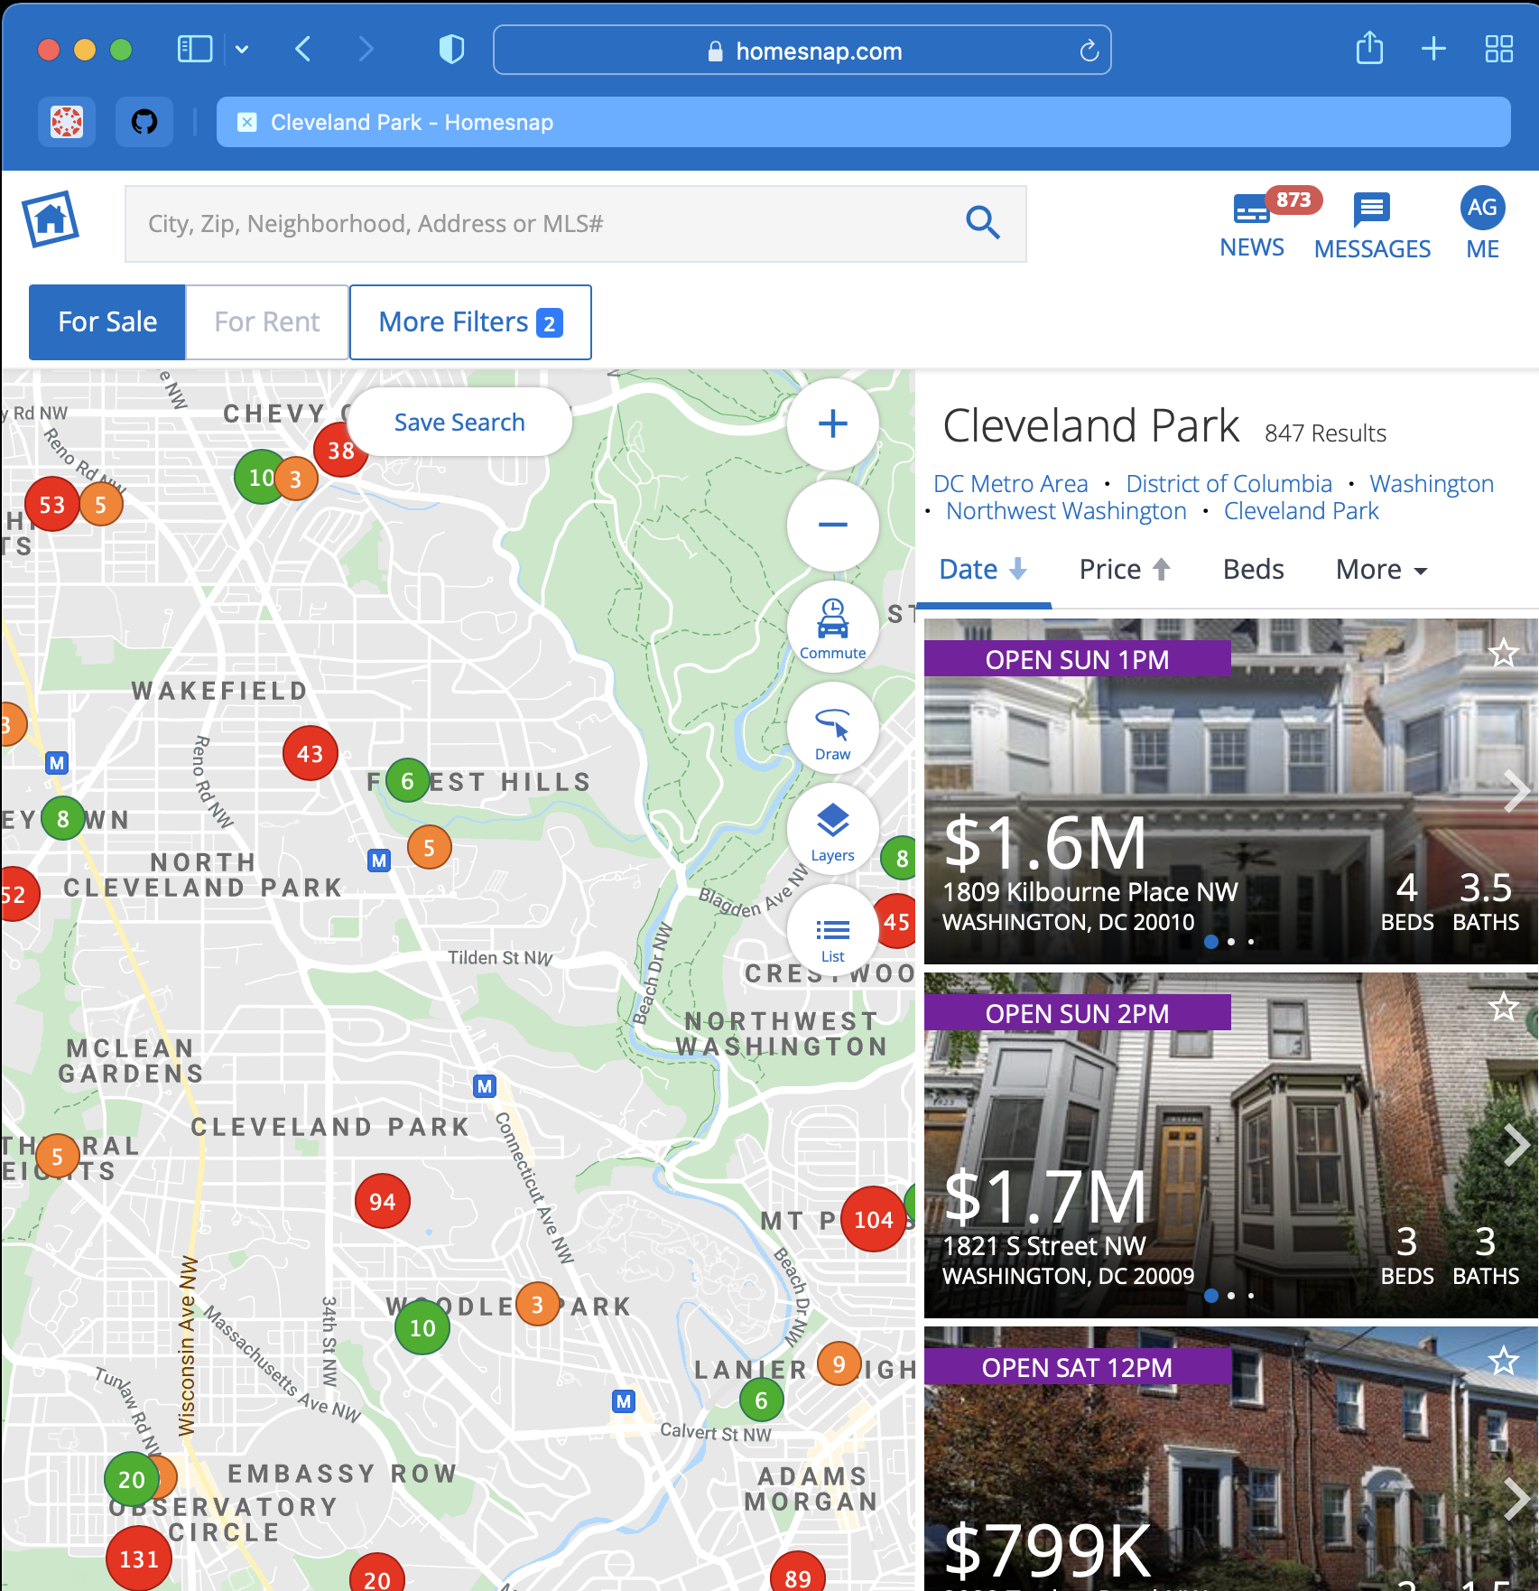



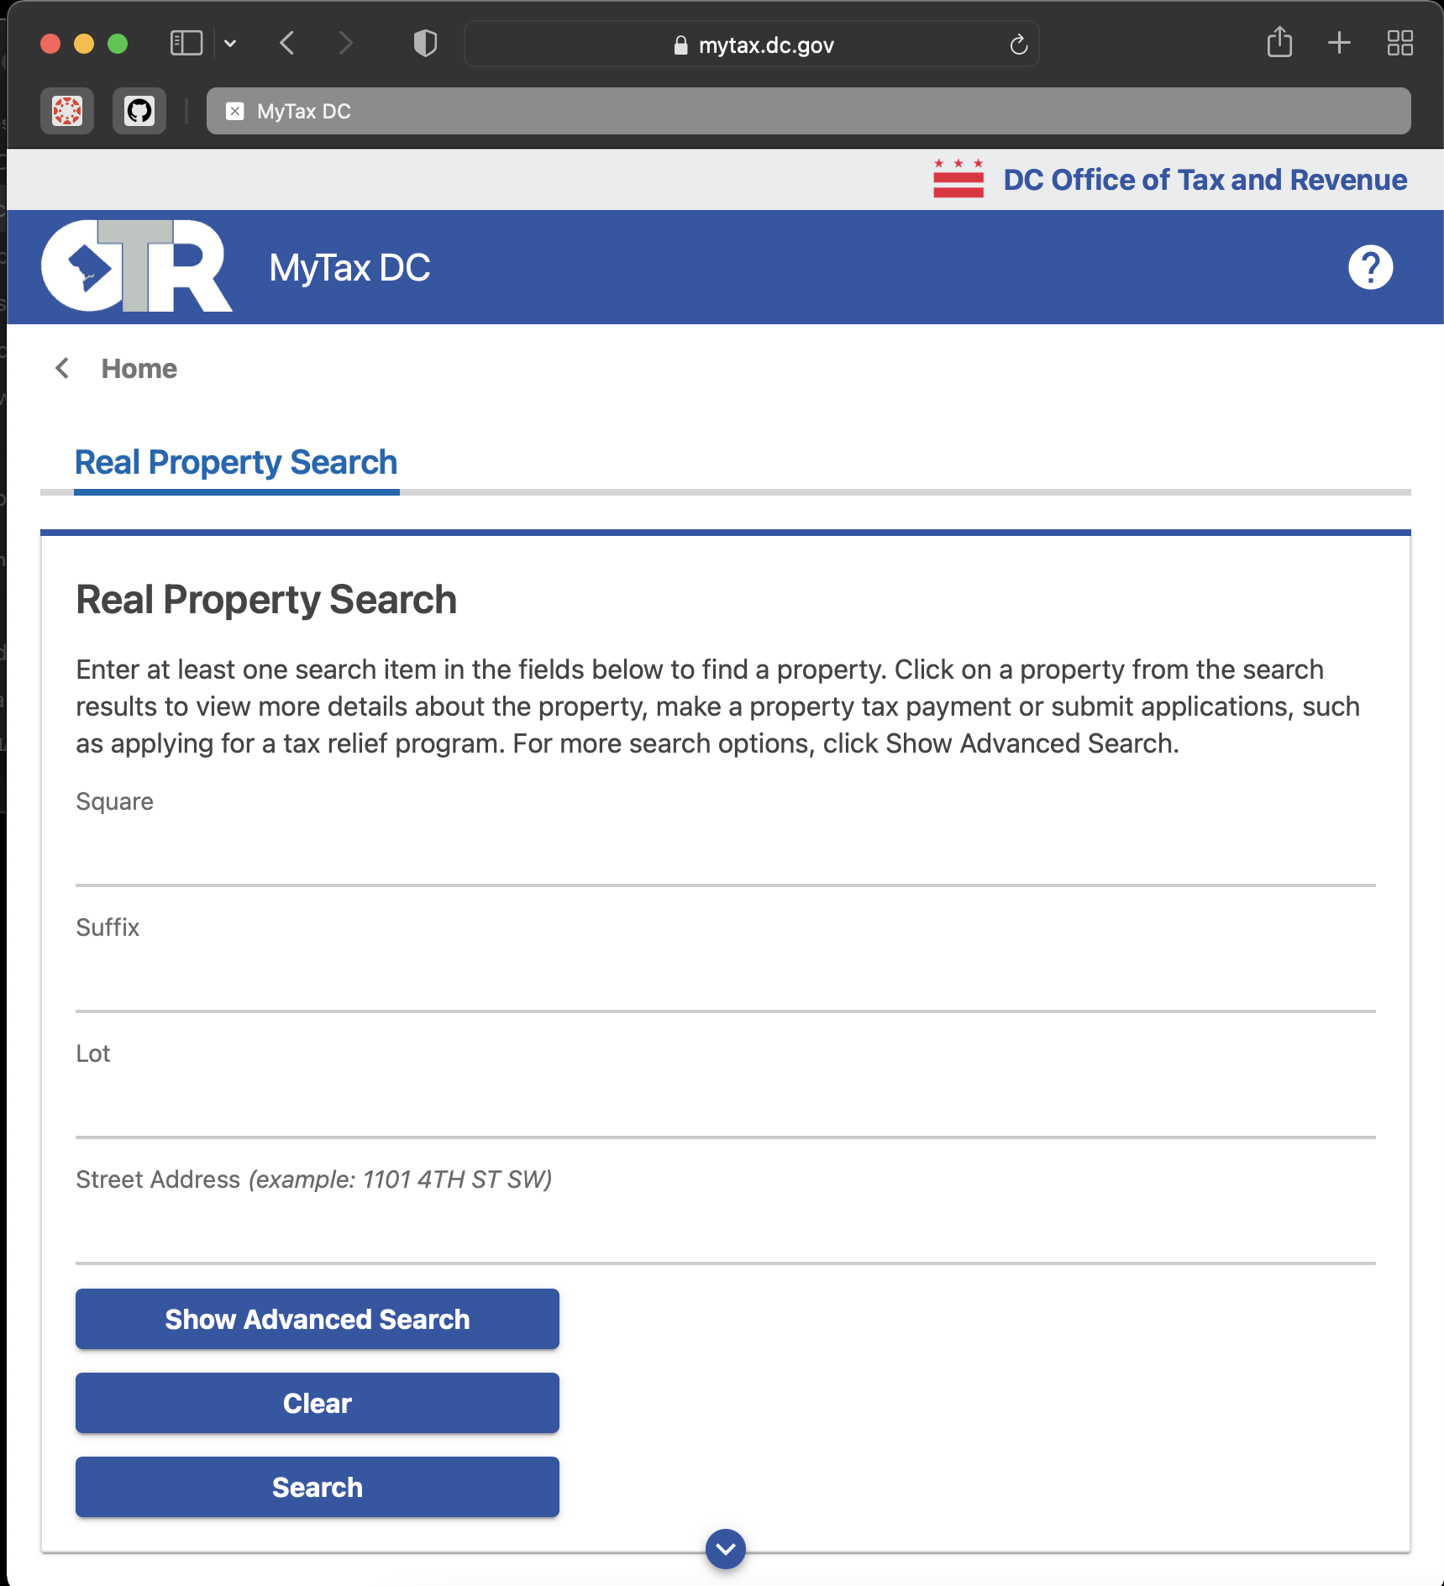

Terminology
Sales Price LM
Asking
Price
&
Property Assessment
HomeSnap
Target Sales Price
(predicted based on previous sales)
>
DC Property Assessment
Potential Profit

Slide 5
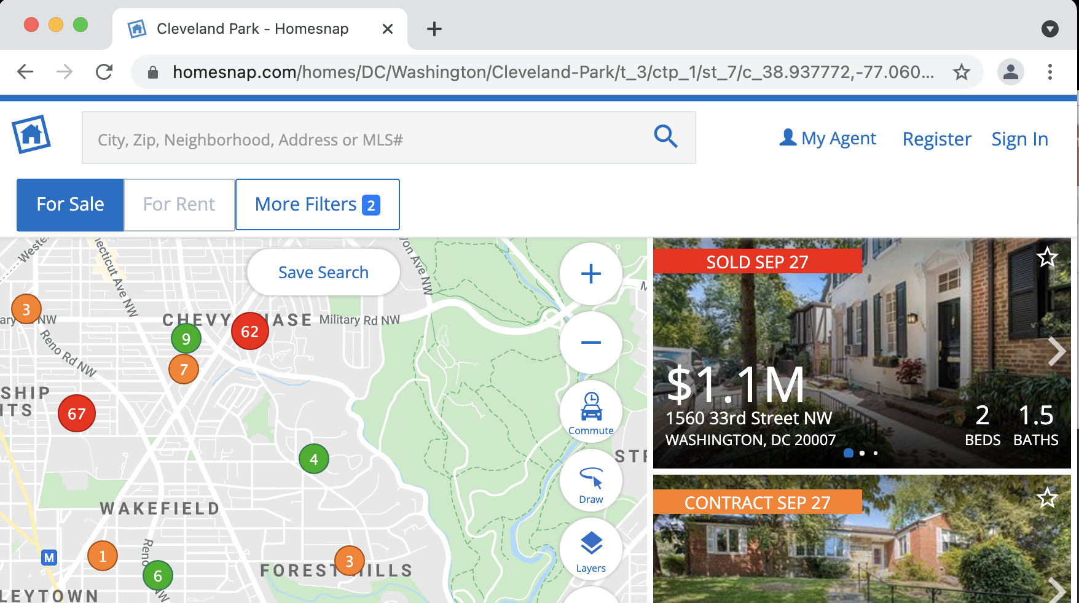
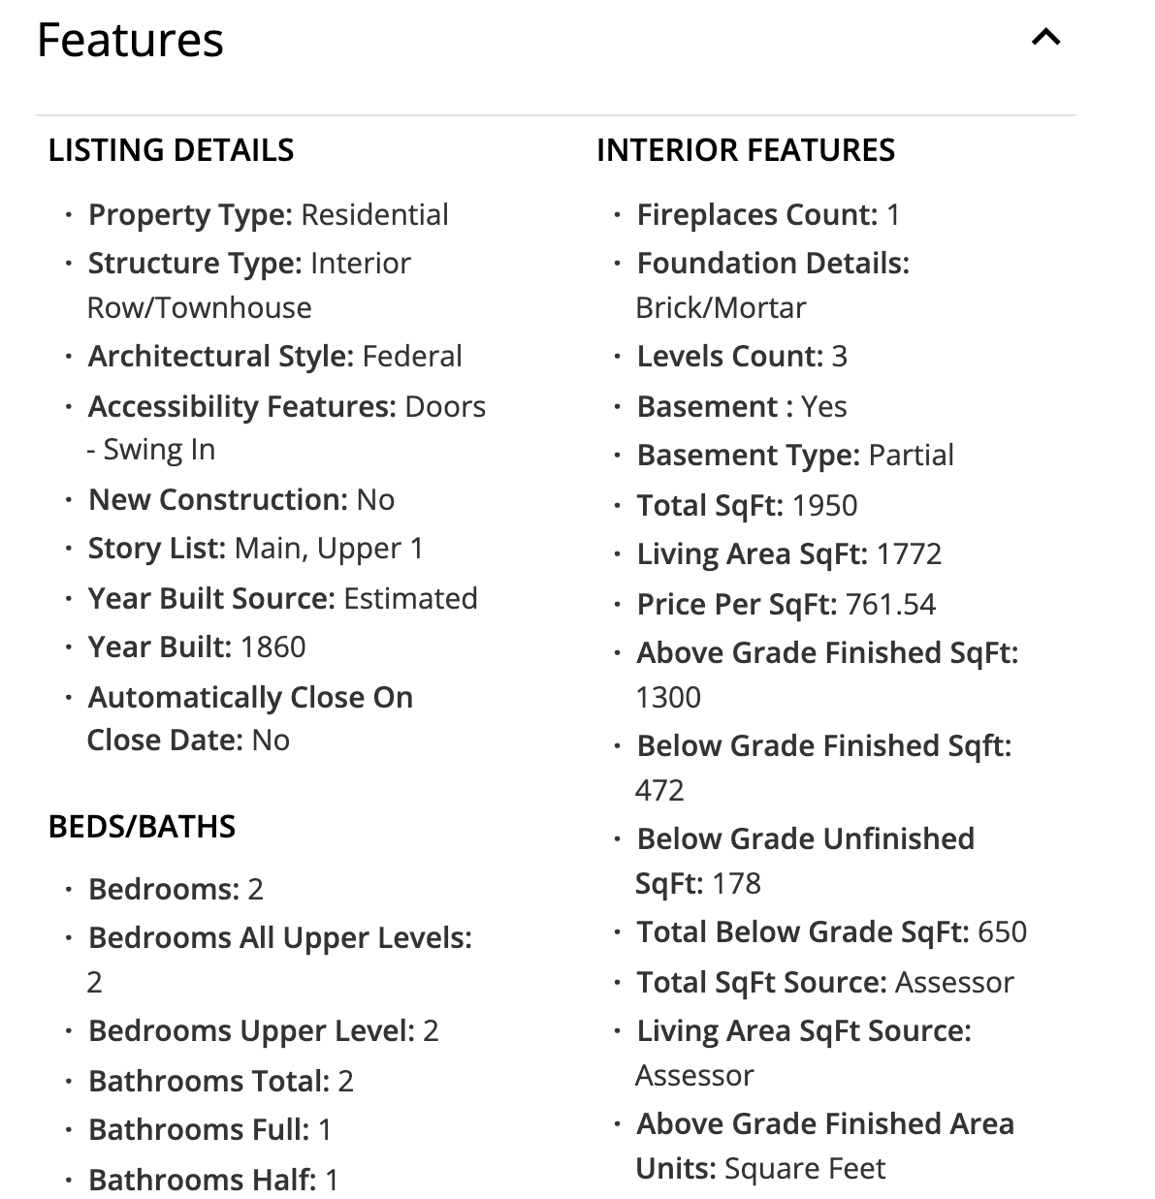
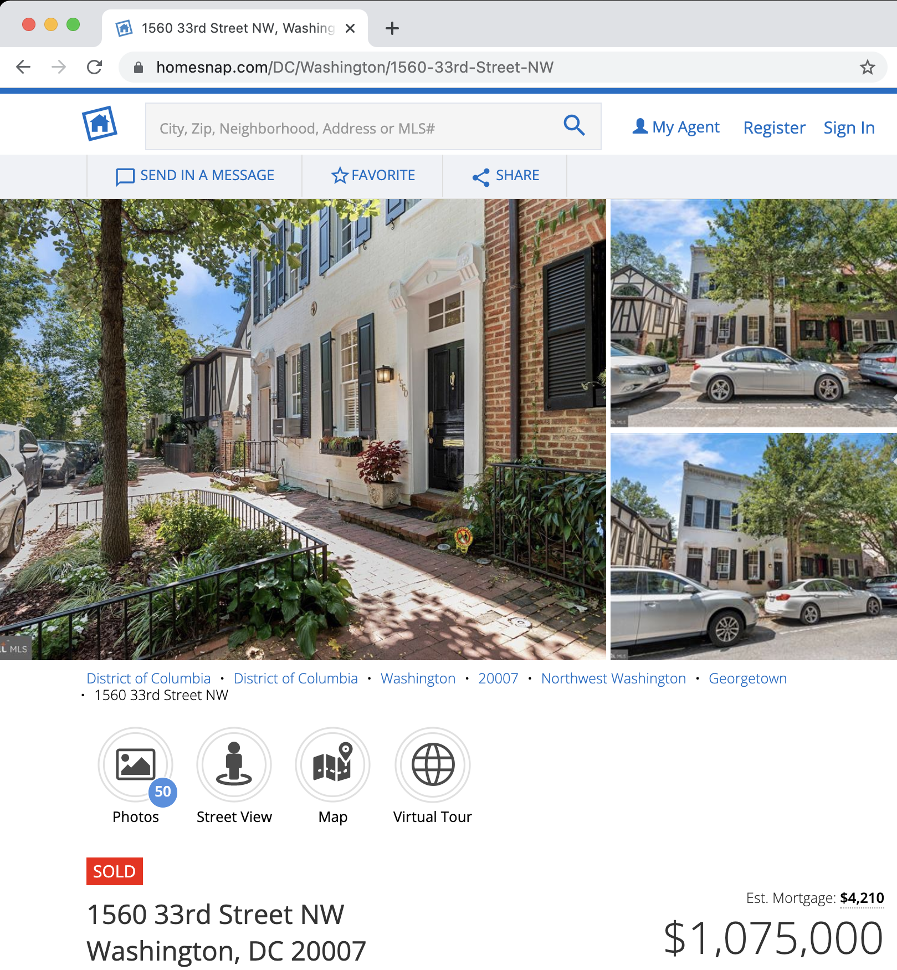
HomeSnap
1020 Properties
492 Sold
251 Contract
277 For Sale
74 Features
Construction
Interior
Exterior
Location
Utilities
Tax Assessment
School District

Slide 6
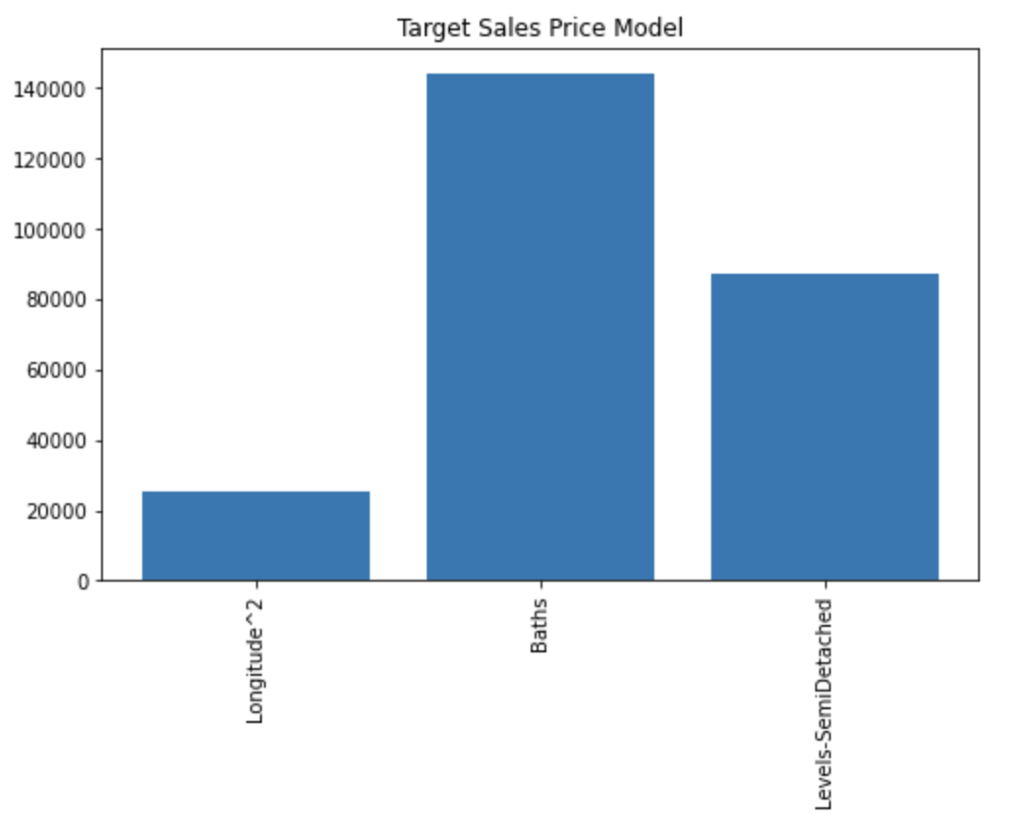
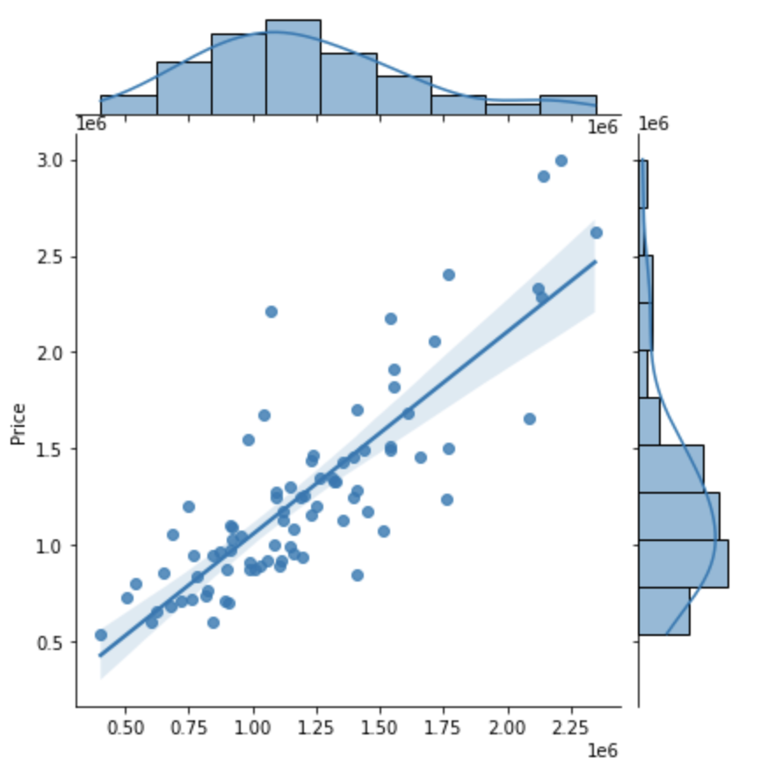
Assessment
Target Sales Price Model
Test Data Fit Model
Coefficient
Actual Sales Price ($K)
Longitude^{2.}
Baths
Levels –
SemiDetached
Predicted (Target) Sales Price ($K)
Intercept -1.45e7
Minor Contributors
MAE $209,243K
R² 0.68
SqFt-SemiDetached | Levels-SqFt
SqFt-Interior Row | ZipCode
SqFt-Baths | SqFt

Slide 7
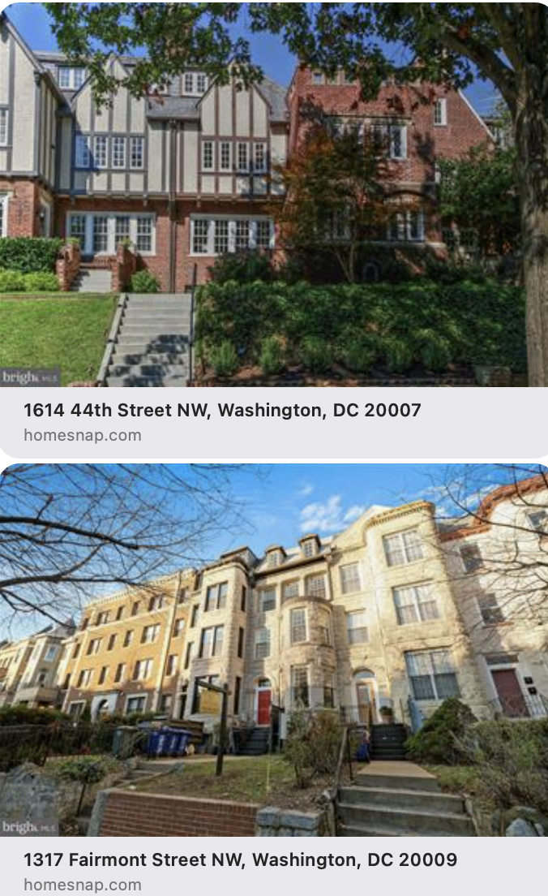
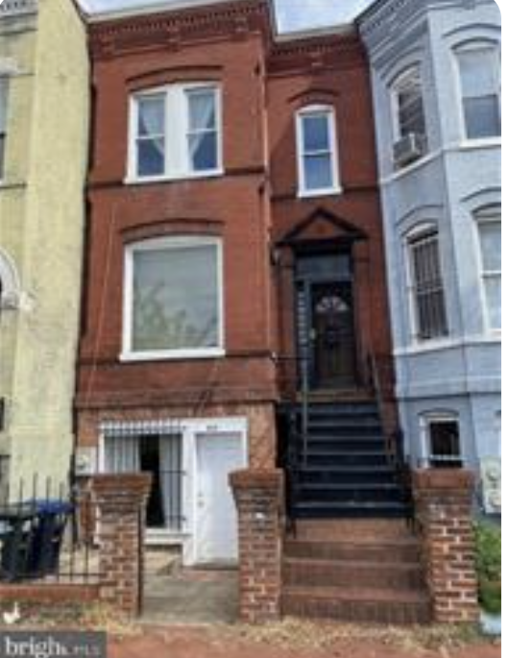
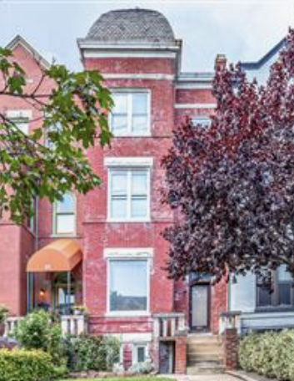
Recommendations
1614 44th Street NW | 1317 Fairmont Street NW | 415 Florida Avenue NW | 59 Bryant Street NW
5 BEDS 3 BATHS 0.05 ACRES 2,419 SQ FT BUILT 1929 Modest Renovation | 8 BEDS 4.5+ BATHS 0.06 ACRES 4,660 SQ FT BUILT 1910 Rental Conversion | 3 BEDS 3 BATHS 0.03 ACRES 1,530 SQ FT BUILT 1890 Significant Renovation | 3 BEDS 4 BATHS 0.06 ACRES 3,482 SQ FT BUILT 1906 Significant Renovation
$1,395,000 Current Price $990,670 Assessment | $2,000,000 Current Price $1,275,140 Assessment | $980,000 Current Price $703,240 Assessment | $1,300,000 Current Price $1,057,610 Assessment
$1,501,115 Target Price $106K - $510K Potential | $2,108,575 Target Price $108K – $833K Potential | $933,632 Target Price $230K Potential | $1,476,489 Target Price $176K - $419K Potential

Slide 8
Future Work
As we learn the DC market and increase the number of properties in the Sold category, the model will improve
Additional feature engineering may improve the overall model fit
Categorize the Zip Codes
Add a categorized Legal Subdivision feature

